Slide 1
SENTIMENT ANALYSIS
TO DETECT DEPRESSION VIA TWITTER

Slide 2
TEAM MEMBERS
Shamika Karnik
Sahithi Shetty
Sonal Singh
Anushka Thakkar
Brinda Bhanderi

Slide 3
TABLE OF CONTENTS
01
02
04
03
ABSTRACT
INTRODUCTION
PHASE 1 RESEARCH
PHASE 2
PRE-PROCESSING
05
06
07
08
PHASE 3
TRAINING & TESTING
DEPLOYMENT & WORKING OF MODEL
FUTURE SCOPE
CONCLUSION
___________________________________________________________________________________________________________________
__________________________________________________
__________________________________________________
__________________________________________________

Slide 4
ABSTRACT
Social media platforms are becoming an integral part of people’s life.
Hence, we used one such platform - twitter to identify the causes of depression and detect it.
Twitter is the most suitable social media network for getting enough data and also to protect us from privacy laws.
Sentiment analysis intends to find the nature of text and classifies into positive, negative and neutral.
The aim of the project is to apply natural language processing on Twitter feeds for conducting emotion analysis focusing on depression.
Used numerous machine learning algorithms for the classification of the tweets.

Slide 5
INTRODUCTION
Depression is a mental illness that is not taken seriously.
Risk of early death is increasing due to this.
There are many experiences that can cause depression.
Depression creates suicidal thoughts causing serious impairments in daily life.
Detecting earlier depression can be a huge step to address the mental illness and offer support to the people suffering from this terrible mental illness.

Slide 6
PHASE 1
RESEARCH
Dataset
Creating a model to detect depression in tweets
Research conclusion
Two kinds of tweets required: random tweets and depressive tweets.
Both the datasets have been downloaded from kaggle.
Many ways for sentiment analysis such as: decision-based systems, Bayesian classifiers, support vector machines, neural networks and sample-based methods.
Read research papers about using different ML & AI techniques to detect depression on Social Media
Decided to apply sentiment analysis through a powerful theorem - model to be written in python and it will tell whether a given tweet is depressive or not.

Slide 7
PHASE 2
PRE-PROCESSING
Cleaning the datasets to obtain only required message texts and the nature of the tweet.
Extracting tweets from raw dataset
Removing special characters
Removing image url
Removing hyperlink
Process tweet
Raw dataset from kaggle
Dataset was filtered

Slide 8
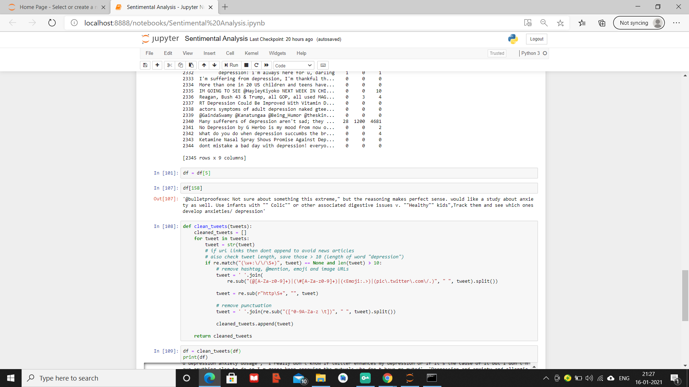
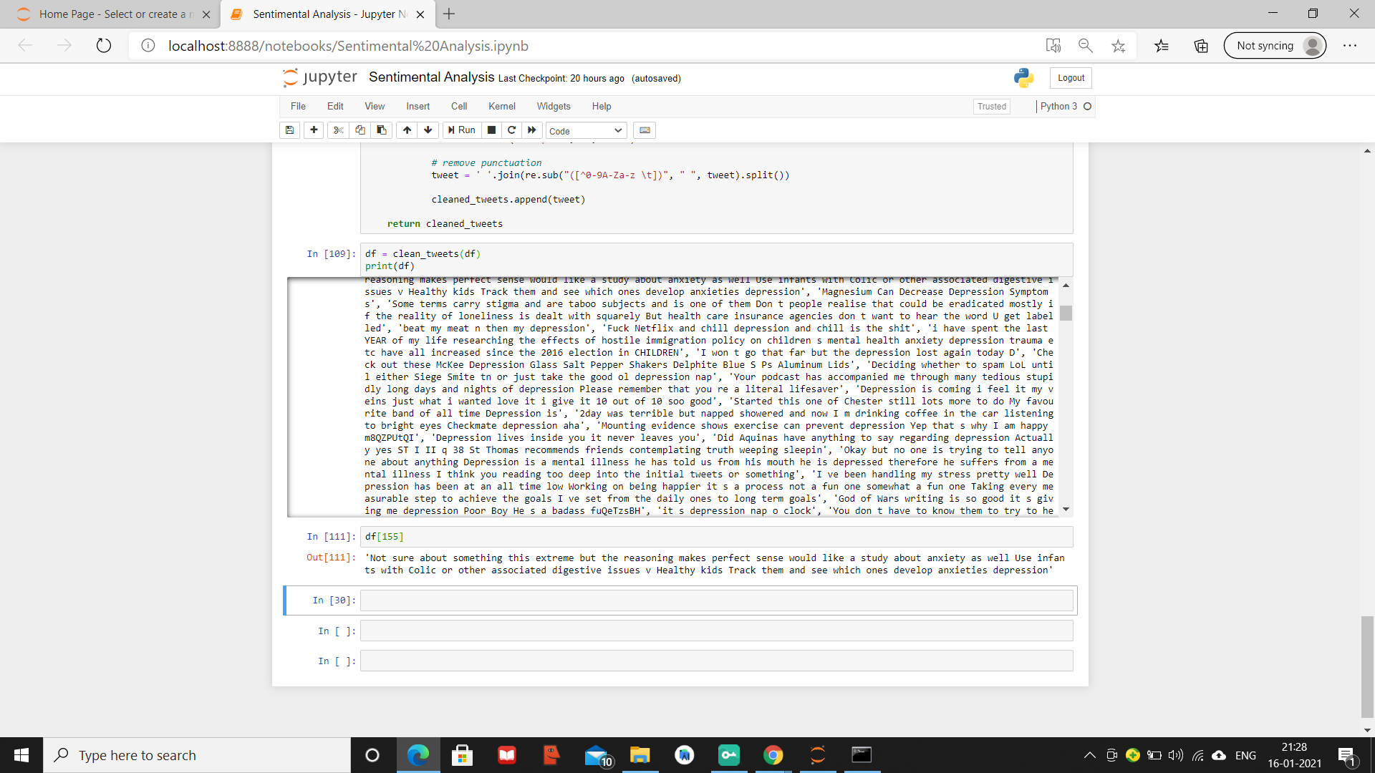
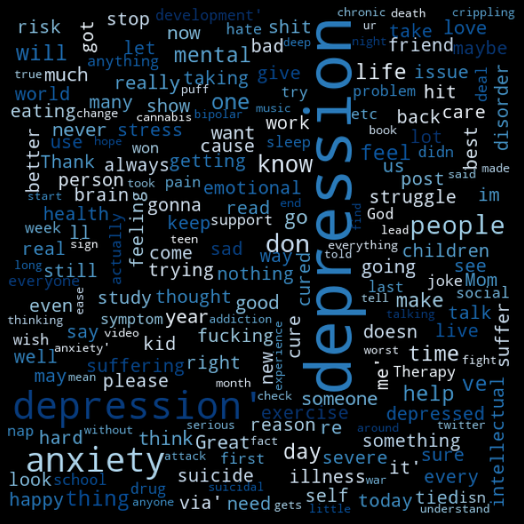
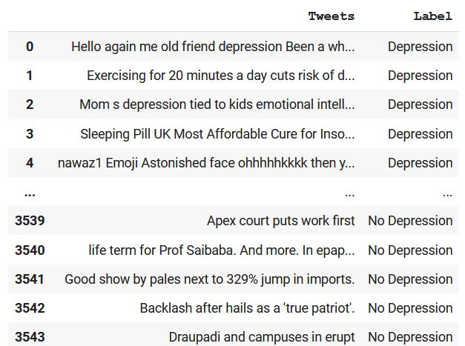
Before pre - processing the data
After pre - processing the data
After cleaning the data, we concatenated depressive and positive tweets, to generate a single CVS.
Generated a word cloud with the most used keywords

Slide 9
PHASE 3
TRAINING & TESTING
Worked on the following models
Multinomial Naive Bayes
Logistic Regression
Gaussian Naive Bayes
Linear SVM
Random Forest Classifier
TRAINING PHASE
TfidfVectorizor was used to convert the tweets into vectors before feeding it to the model.
Creation of predictive model
TESTING PHASE
30% of data split randomly and tested on the predictive model.
The test data is pre-processed and classified either positive or negative.

Slide 10
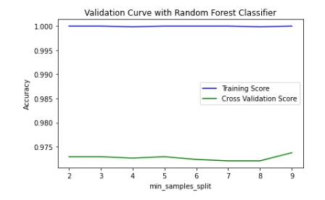
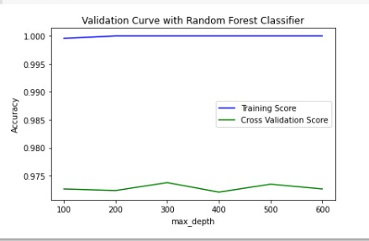
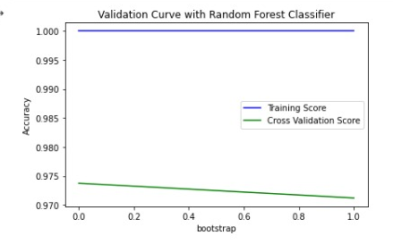
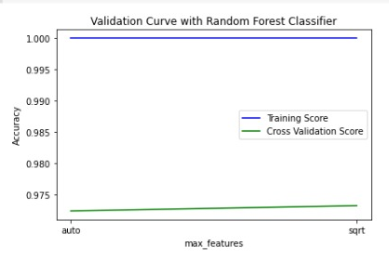
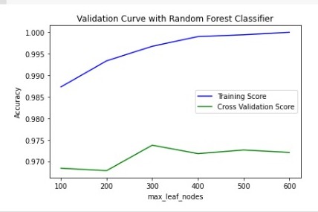
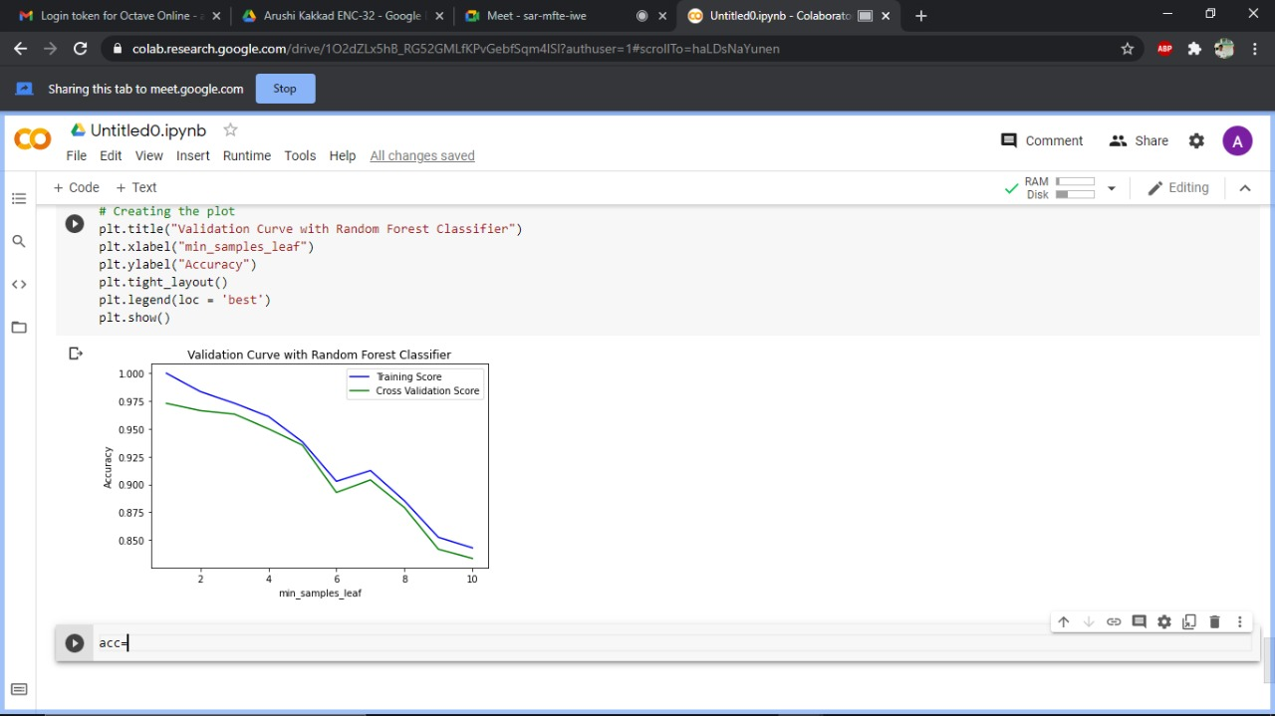
OPTIMISATION
Plotted Validation Curve of the hyperparameters of Random Forest Classifier to look for best results.
We also used RandomizedSearchedCV method for hyperparameter Tuning, which gave accuracy of 97.828%

Slide 11
COMPARATIVE ANALYSIS
91.118%
97.828%
96.57%
88.815%
97.171%
MULTINOMIAL NAIVE BAYES
LOGISTIC REGRESSION
GAUSSIAN NAIVE BAYES
LINEAR
SVM
RANDOM FOREST CLASSIFIER
Accuracies of the 5 approaches are given below:

Slide 12
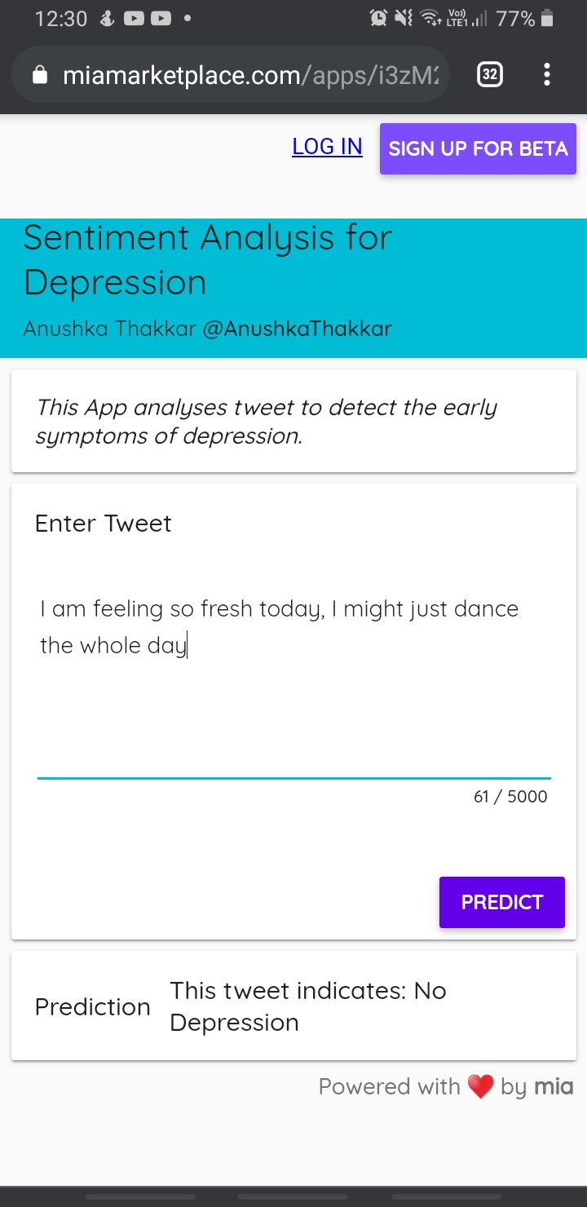
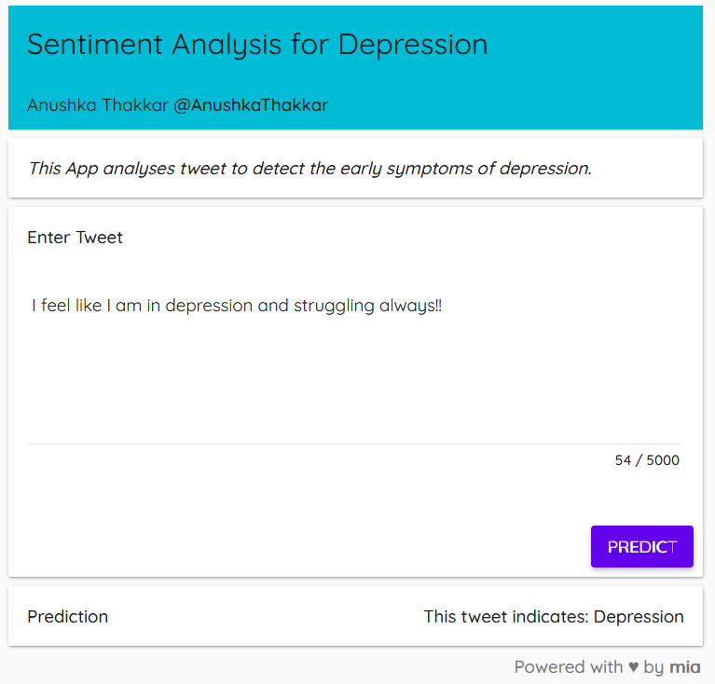
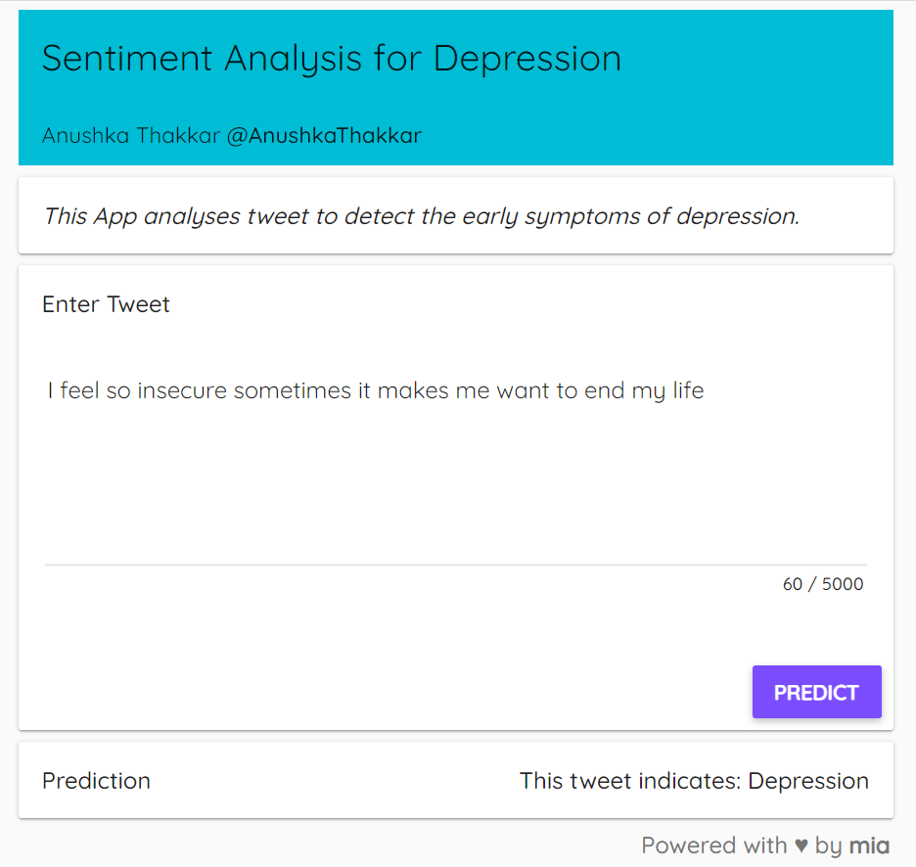
DEPLOYMENT & WORKING OF MODEL
Model has been deployed on mia. Here are some snapshots of the deployment and the output.
The link of the same can be found here: https://miamarketplace.com/apps/i3zM28I1GlEgh47X2mG0XhWpRxikx_YEOU6pu7KWUAYN

Slide 13
FUTURE SCOPE
In future post, we want to share the work with the same dataset but using deep learning techniques.
Depression can be detected in other features, such the time when a person tweets.
There are many factors we can analyze in order to make better conclusions.
Detect early symptoms of depression and make a chatbot who can chat with the person and then contact therapist.
Give an individual insight into his/her mental health far earlier than traditional approaches.
Use more models to analyse tweets and more social media outlets to determine various other mental health issues.

Slide 14
CONCLUSION
Novel approach word embedding for classification tasks to detect the depressive tweets from Twitter.
The model works good in predicting some tweets sentiment but it can get better with more data.
The difficult part was finding an annotated dataset.
Cleaning the data to get it ready for analysis took us some sometime.
A step towards building a complete social media-based platform for analyzing and predicting mental and psychological issues and recommending solutions.

Slide 15
REFERENCES
Latha A, “DEPRESSION DETECTION WITH SENTIMENT ANALYSIS OF TWEETS”, International Research Journal of Engineering and Technology (IRJET), vol. 06, 05 May 2019. [Accessed December 29, 2020].
Hatoon AlSagri & Mourad Ykhlef, “Machine Learning-based Approach for Depression Detection in Twitter Using Content and Activity Features”, 2020. [Accessed January 10, 2021].

Slide 16
THANK YOU!

